Slide 1


Fraud Detection in Financial Transactions
Aug 2019
Shefali Bharti
Girish Kale
Behrang Shirazi
Machine Learning - 3253

Slide 2

Business case
Identify if a transaction is fraud?
About data
Dataset is for a financial transaction which has already published in Kaggle and is a sample of real transactions extracted from one month of financial logs from a mobile money service implemented in an African country.
The original published dataset has 7 features in 6 millions transactions.
1) Step 2) Type 3) Amount 4) nameOrig 5) oldbalanceDest 6) newbalanceDest 7) isFraud 8) isFlaggedFraud
There is no time series features was captured in the dataset.
Too few examples of ‘known’ fraud in the dataset.

Slide 3

Overall Objectives
Achieve high fraud detection rate (True Positive) with low false alarm (False positive)
Multiple algorithms for higher accuracy
Ensure optimality of models without overfitting and underfitting
Visualize models to interpret results

Slide 4
Our Approach
Exploratory Data Analysis
Model Evaluation
Data preprocessing
Model training
Feature engineering

Slide 5
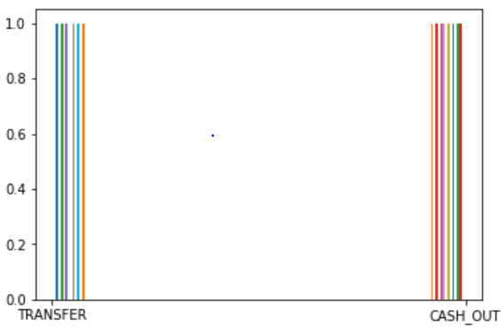
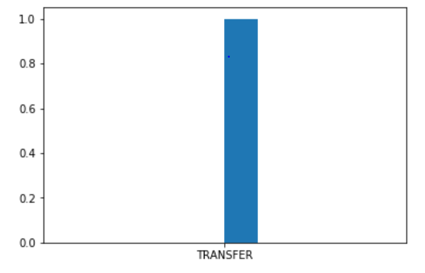
Exploratory Data Analysis
Is Fraud
With 5 types of transactions – fraud occurs only in two of them – TRANSFER and CASH OUT.
Percentage of fraudulent transactions identified as Fraudulent – True Positive (TP) = 0.021% (1252/6M)
Maximum amount transacted when Fraud occurred = 10M (Local Currency)
Total Fraud transactions amount = 1,821,373,636.05 (Local Currency)
Is Flagged Fraud
With 5 types of transactions – Flagged fraud occurs only in one of them – TRANSFER.
Percentage of genuine transactions identified as fraudulent – False Positive (FP) = 0% (0/6M) i.e. (isFlaggedFraud == 1) & (df.isFraud == 0)

Slide 6
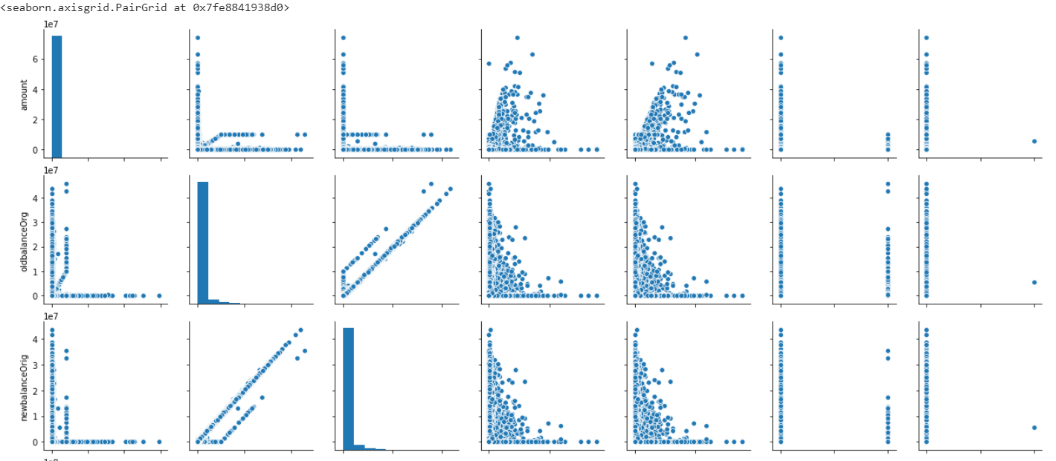
Histograms
OUTLIERS

Slide 7
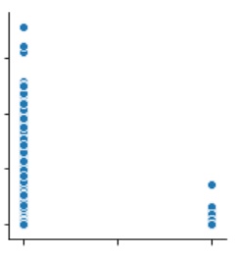
Histogram - Findings
Low original balance in destination is more prone to Fraud than High original balance
Old Balance Destination
Since there are unique 949,802 Origination Accounts and 623,785 destination accounts
No Fraud
Fraud
An attempt at one hot encoding of these accounts lead to a very sparse matrix, followed by curse of dimensionality crashing the program.

Slide 8
Data Preparation
Transforming
Splitting
Normalization
Oversampling and Under sampling
Transforming categorical data to numeric features.
Splitting data frame to:
80% for training
20% for testing
Normalized train dataset
Transformed test dataset
Over sampling data (SMOTE)
A combination of over sampling and under sampling (SMOTETomek) [Note: 50 minutes to run]

Slide 9
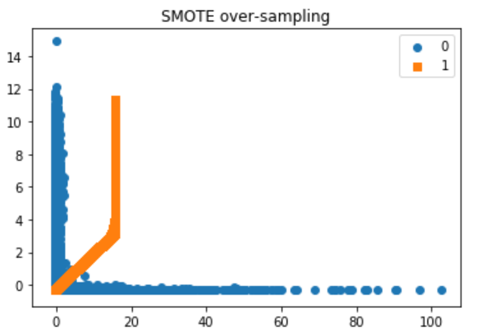
Balancing Data (Oversampling the minority)

Slide 10
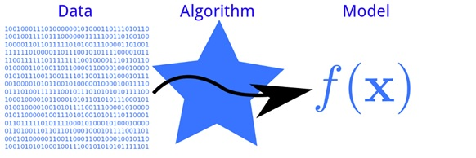
Models
Logistic Regression
Decision Tree Classifier
SGD Classifier
Random Forest Classifier
Voting Classifier

Slide 11
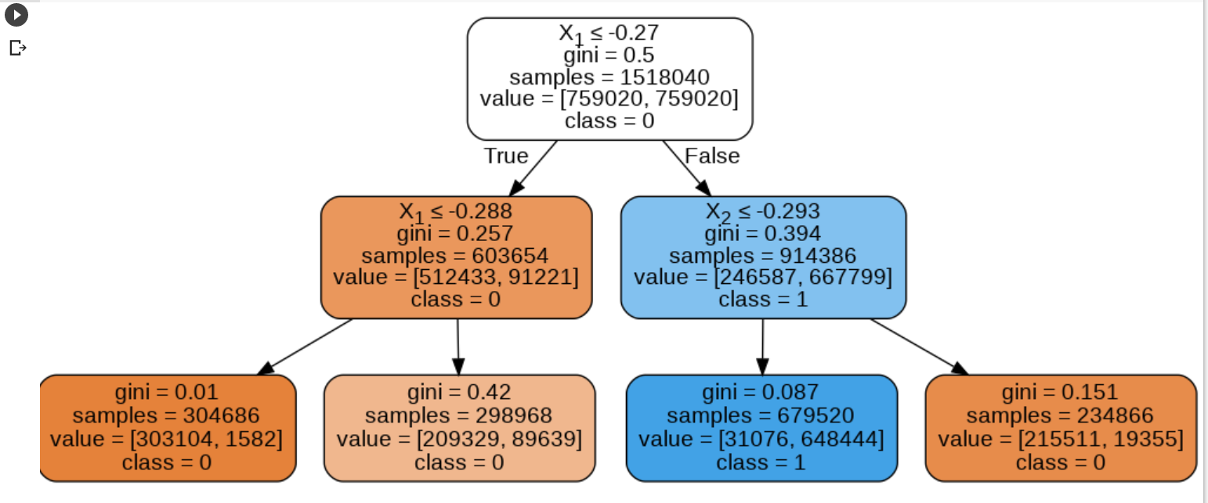
Decision Tree Classifier

Slide 12

PCA Experiment
Reduced dimensions to 3 by using PCA.
Running the PCA over the original data provided 99% accuracy and 0 for Precision and Recall.
Running PCA on the over sampled data 38% accuracy, 0 Precision and 0.6 Recall

Slide 13
Results
Model | Accuracy | Precision | Recall | AUC ROC | Confusion Matrix
SGD Classifier before SMOTE | 0.998 | 0.52 | 0.0604 | 0.53 | [[189773 12] [ 202 13]]
SGD Classifier with SMOTE | 0.96 | 0.025 | 0.85 | 0.906 | [[182276 7500] [ 33 191]]
Logistic Regression with SMOTE | 0.955 | 0.0256 | 0.926 | NA | NA
Decision Tree with SMOTE | 0.97 | 0.041 | 0.99 | 0.901 | [[181882 7894] [ 35 189]]
Random Forest Classifier | 0.998 | 0.479 | 0.892 | 0.945 | [[189559 217] [ 24 200]]
Voting Classifier | 0.988 | 0.084 | 0.884 | 0.936 | [[187643 2133] [ 26 198]]

Slide 14
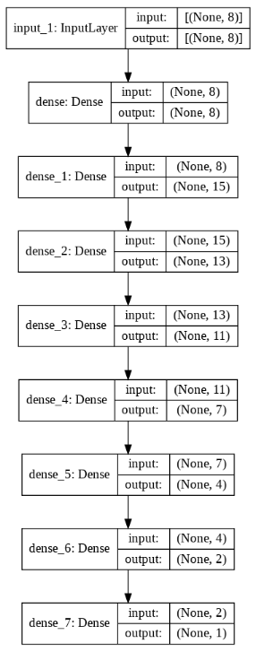
Tensor Flow
Approach towards Layers
Funnel shaped
Initial Expansion followed by the Funnel shape
Activation Function ='relu'
Loss Function = 'binary_crossentropy’
Optimizer = 'Adam', Adagrad
Learning Rates = ‘0.001’, ‘0.01’, ‘0.1’
Accuracy = 49.96%

Slide 15
Next Steps
Try feature engineering by extending the features
Bucketing of amounts into various ranges
Logarithm of amounts
More model optimization.
Hyper parameter Tuning
Trying using pipeline for deployment

Slide 16

GitHub:
https://github.com/ml213/frauddetection

